Slide 1
Xamarin.Forms 實戰教學
Daedalus Studio CTO 吳吉米

Slide 2
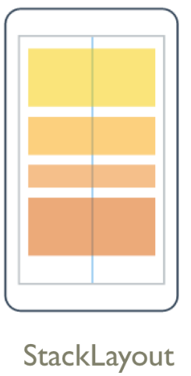
StakeLayout

Slide 3
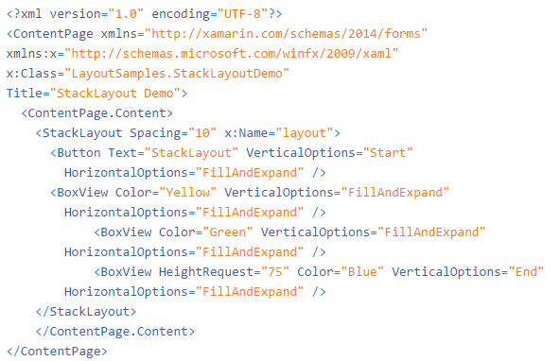
StakeLayout in Xaml

Slide 4
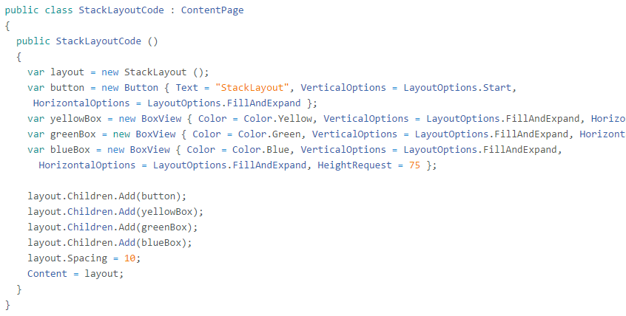
StakeLayout in code

Slide 5
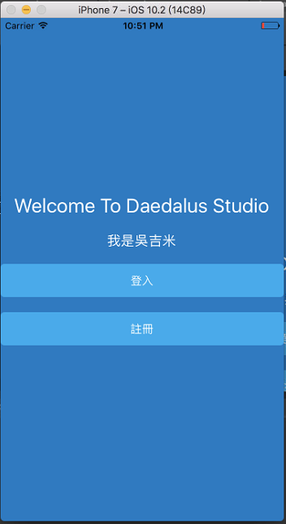
Example 1

Slide 6

Example 2

Slide 7
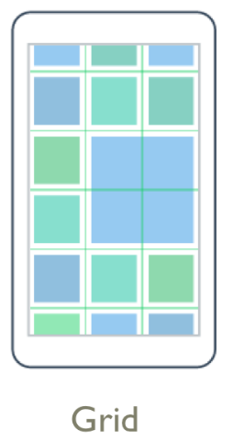
Grid

Slide 8
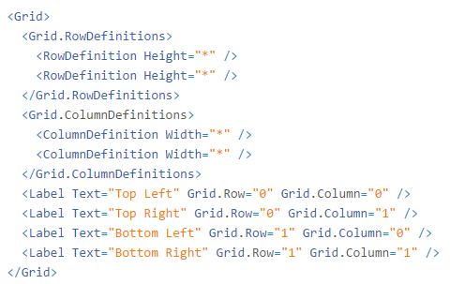
Grid in Xaml

Slide 9
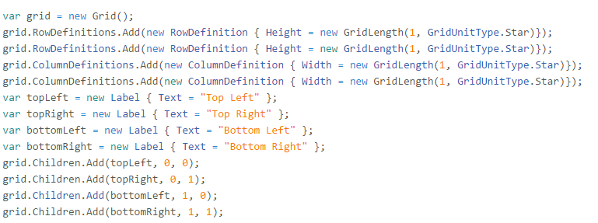
Grid in code

Slide 10
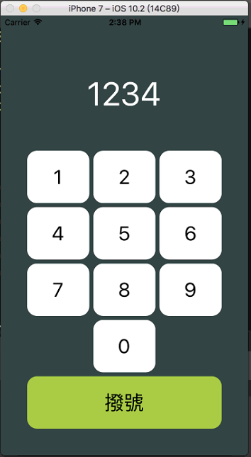
Example 1

Slide 11
Example 1

Slide 12
Example 1

Slide 13
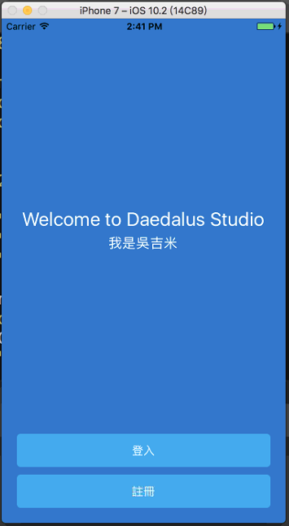
Example 2

Slide 14
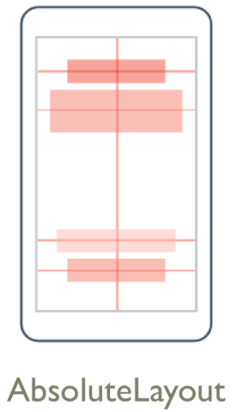
AbsoluteLayout

Slide 15
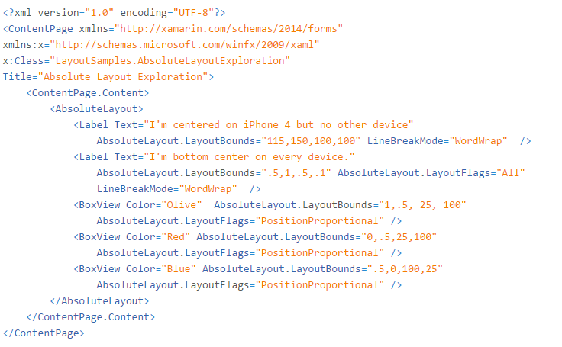
AbsoluteLayout in Xaml

Slide 16
AbsoluteLayoutFlags
None
All
WidthProportional
HeightProportional
XProportional
YProportional
PositionProportional
SizeProportional

Slide 17
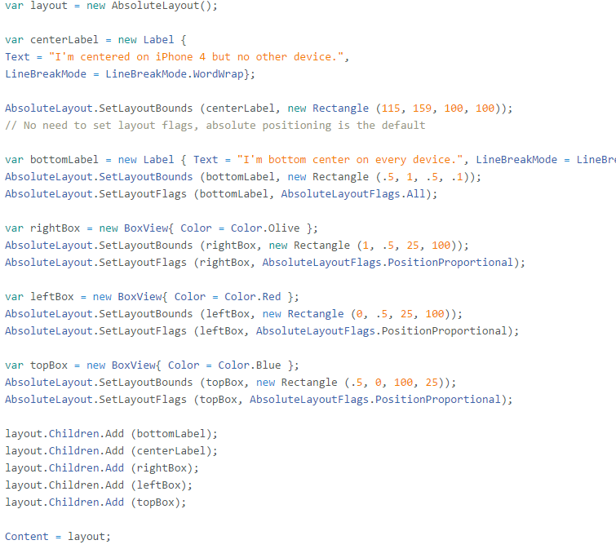
AbsoluteLayout in code

Slide 18

Example 1

Slide 19

Example 2

Slide 20

RelativeLayout

Slide 21
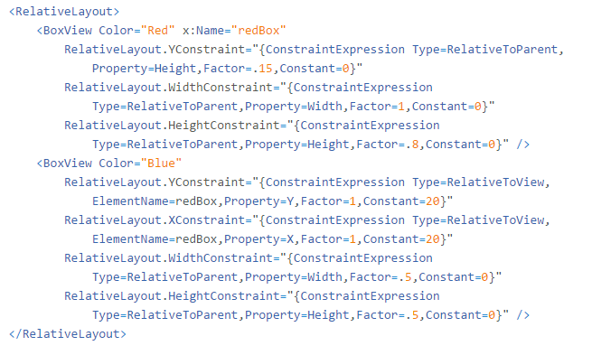
RelativeLayout in Xaml

Slide 22
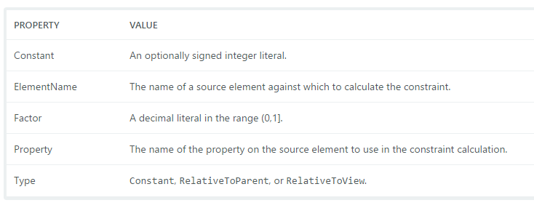
ConstraintExpression

Slide 23
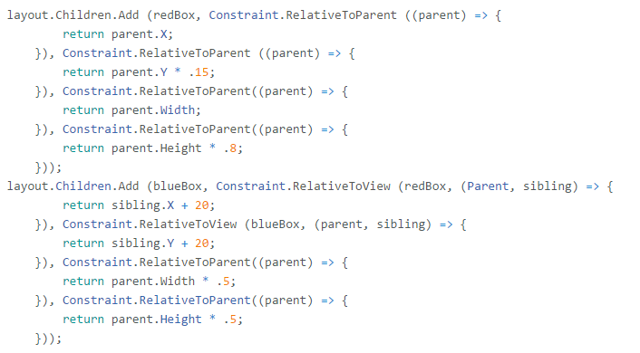
RelativeLayout in code

Slide 24
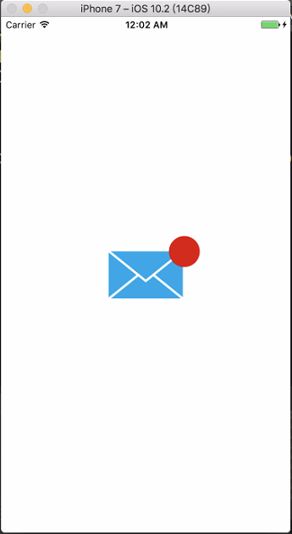
Example 1

Slide 25

Example 2

Slide 26
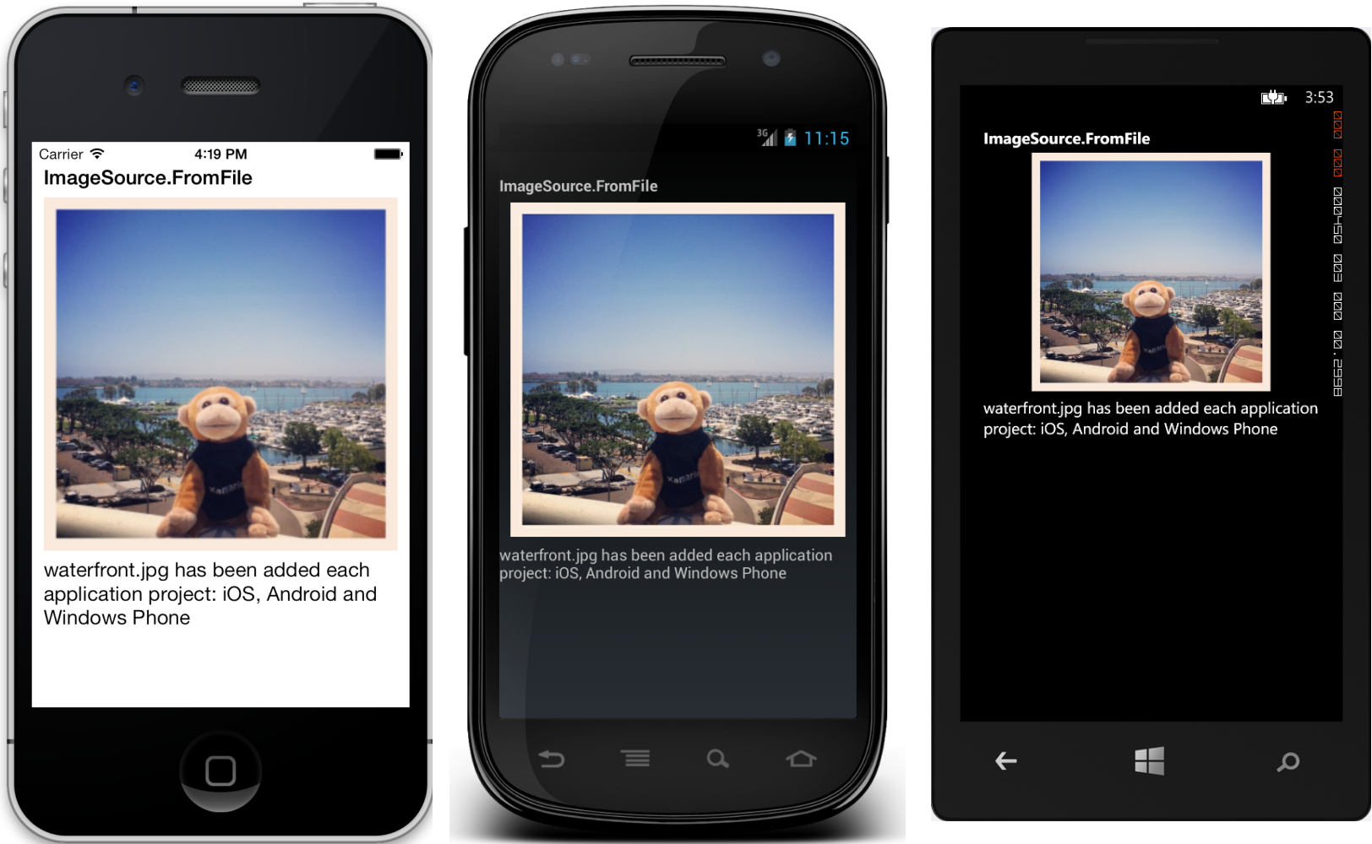
Image

Slide 27



Aspect
AspectFill
AspectFit
Fill

Slide 28
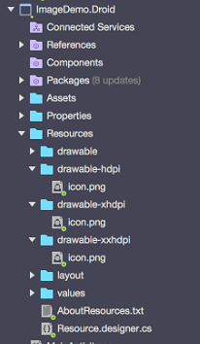
Local images (Android)
Drawable
Drawable-hdpi
Drawable-xhdpi
Drawable-xxhdpi
Build Action: AndroidResource

Slide 29
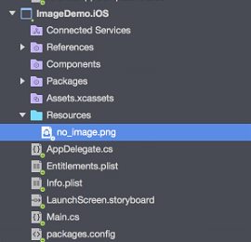
Local images (iOS)
Image.png
Image@2x.png
Image@3x.png
Build Action: BundleResource

Slide 30
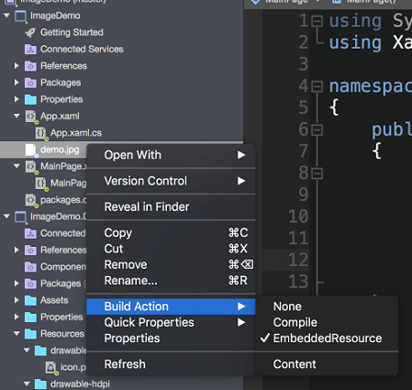
Embedded Images (PCL)
Build Action: EmbeddedResource

Slide 31
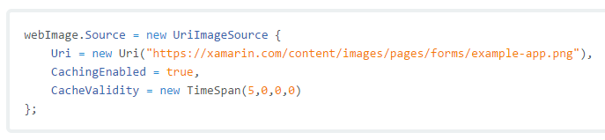
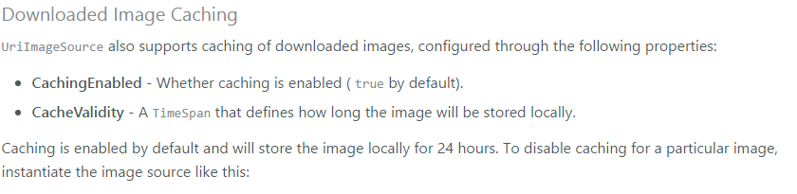
Downloading Images

Slide 32
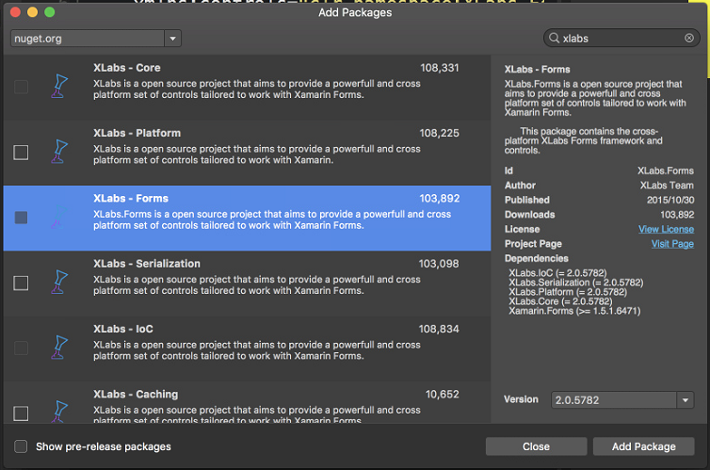

Xlabs
https://libraries.io/github/XLabs/Xamarin-Forms-Labs

Slide 33

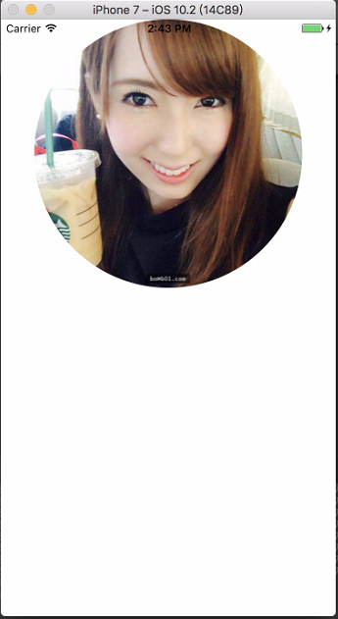
CircleImage

Slide 34
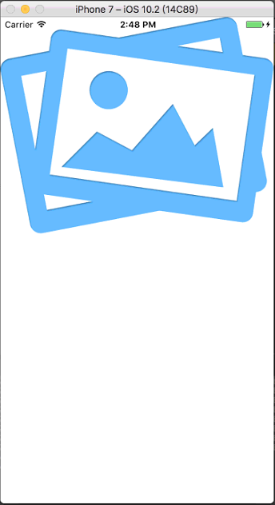

WebImage
download…

Slide 35
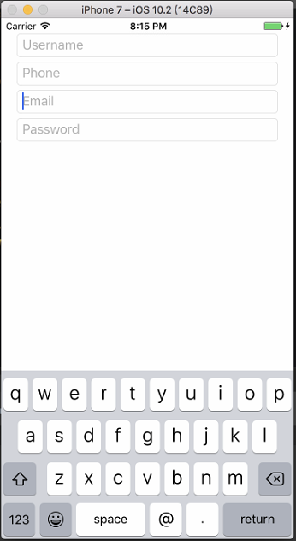
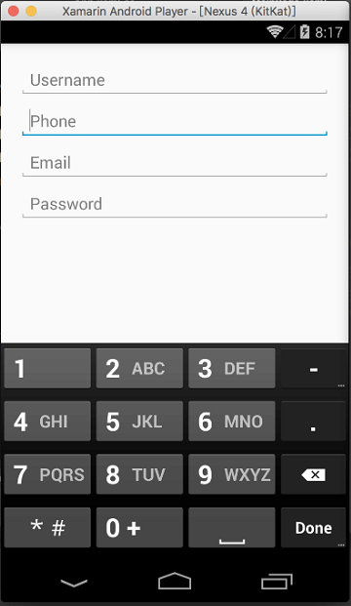
Entry & Edit

Slide 36
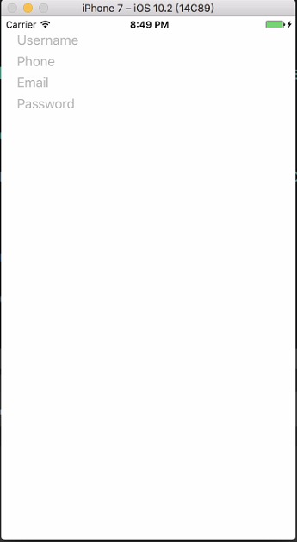
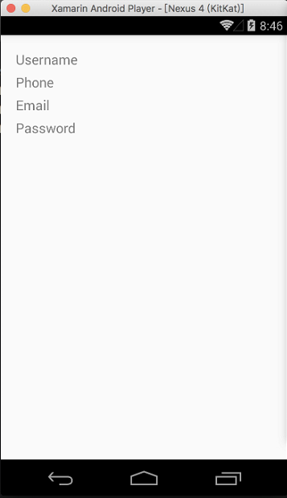
NoBorderEntry

Slide 37
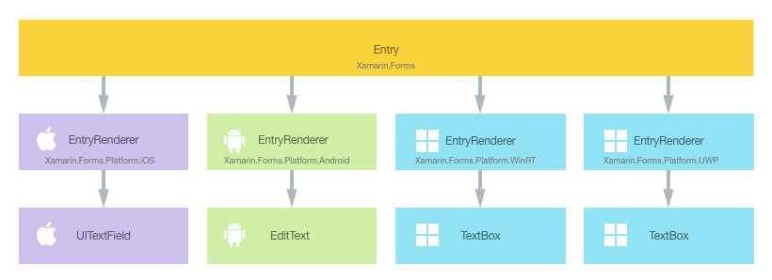
Renderer
https://developer.xamarin.com/guides/xamarin-forms/custom-renderer/renderers/

Slide 38
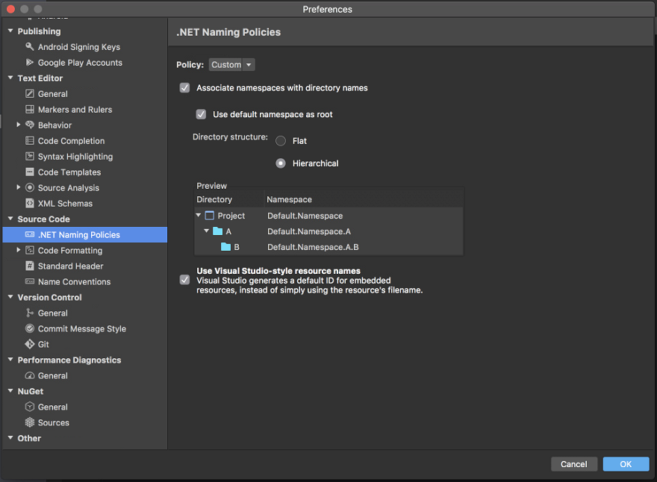
Namespace with directory names

Slide 39
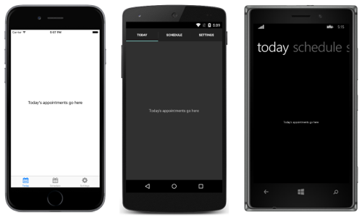
Tabbed Page

Slide 40
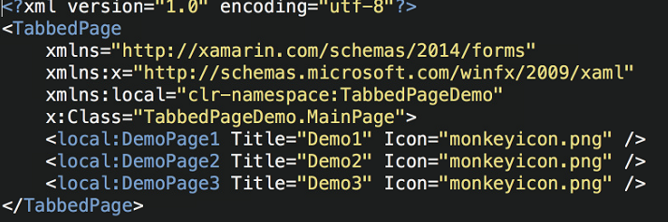
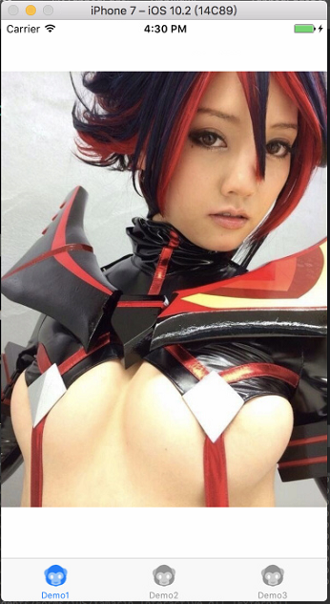


Tabbed Page 結構

Slide 41

跨平台差異????

Slide 42
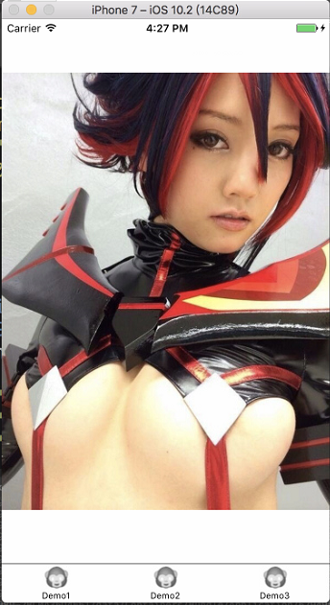

Tabbed Page

Slide 43
Custom Tabbed Page 結構
Grid
ContentView
*
Grid
44

Slide 44

Custom Tabbed Bar 結構
*
*
*

Slide 45
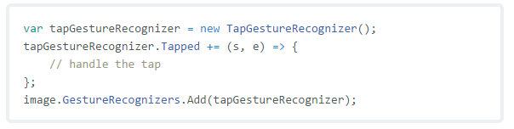
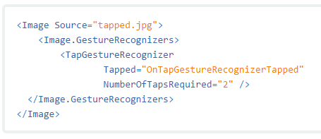
Tap Gesture Recognizer
In Code
In Xaml

